Slide 1
Code Basics Resume Challenge
Revenue Insights to Revenue team in the Hospitality Domain Prepared By:
Ria Sangwan

Slide 2
Atliq Grands
Atliq Grands is a premium hotel chain known for offering high-quality hospitality services across multiple cities.
Operates multiple luxury hotels in different locations, focuses on customer satisfaction, comfort and modern hospitality standards.
Deals with major hospitality functions such as Room Bookings, Revenue Management, Pricing Strategy, Customer experience improvement etc.

Slide 3
Problem Statement
AtliQ Grands owns multiple five-star hotels across India. They have been in the hospitality industry for the past 20 years. Due to strategic moves from other competitors and ineffective decision-making in management, AtliQ Grands are losing its market share and revenue in the luxury/business hotels category. As a strategic move, the managing director of AtliQ Grands wanted to incorporate “Business and Data Intelligence” to regain their market share and revenue. However, they do not have an in-house data analytics team to provide them with these insights.
Their revenue management team had decided to hire a 3rd party service provider to provide them with insights from their historical data.

Slide 4
Project Objective
I am playing the role of a data analyst, who has been provided with sample data and a mockup dashboard, to create a Dashboard according to the mockup provided and create relevant insights that are important for AtliQ Grands to regain their market share and revenue.

Slide 5

Dataset Details
We are provided with Atliq Grands data for bookings:
The dataset contains 4 excel files and 3 reference files for measures and mock-up dashboard:
1. dim_customer
2. dim_date
3. dim_hotels
4. fact_bookings
Metrics file for measures
Meta Data Hospitality
Mock up dashboard file

Slide 6
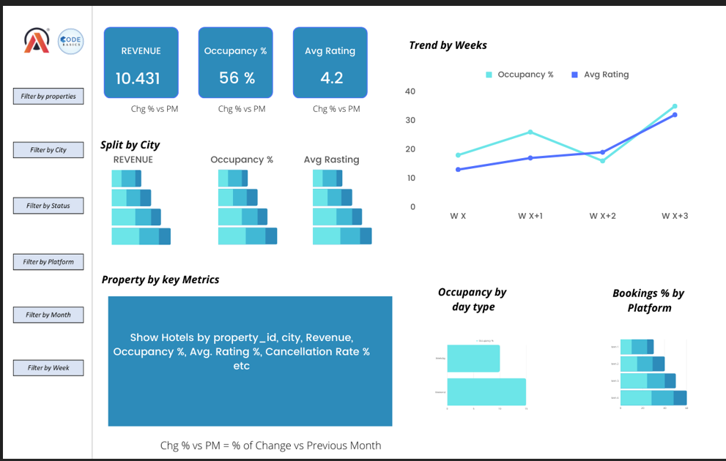
Mock-up Dashboard

Slide 7
Expected Outcomes
To find out which business metrics are not doing well and understand how we can improve them
To analyze weekly and monthly trends of revenue, occupancy, and ratings
To support underperforming hotels and help them regain their market share

Slide 8
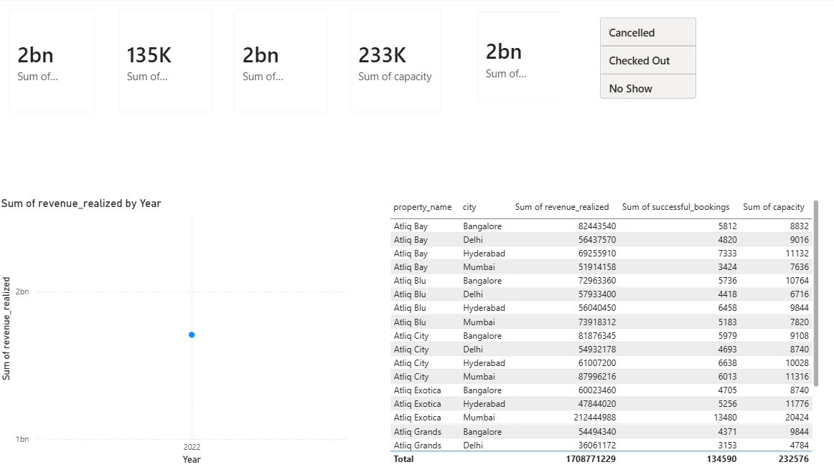
Executive Overview of Atliq Grands
Hotel revenue and Booking Overview:-
₹2Bn+ total revenue generated across properties
135K+ successful bookings recorded
233K total room capacity, indicating strong scale
AtliQ Bay & AtliQ Blu are the top revenue contributors
Metro cities (Bangalore, Mumbai, Delhi) drive the majority of revenue
Checked-out bookings dominate, while cancellations & no-shows remain controlled

Slide 9
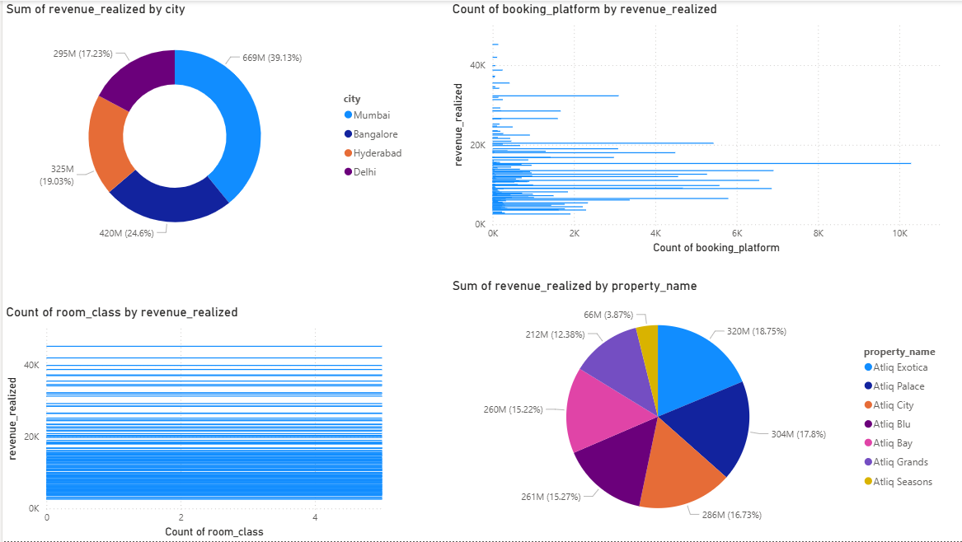
Revenue Insights of Atliq Grands
Revenue Distribution & Booking Insights
Mumbai leads revenue contribution, followed by Bangalore and Hyderabad
Revenue is well diversified across properties, with AtliQ Exotica, Palace, and City as top performers
Online booking platforms drive the majority of bookings, directly impacting revenue
Premium room classes contribute higher revenue, despite lower booking counts

Slide 10
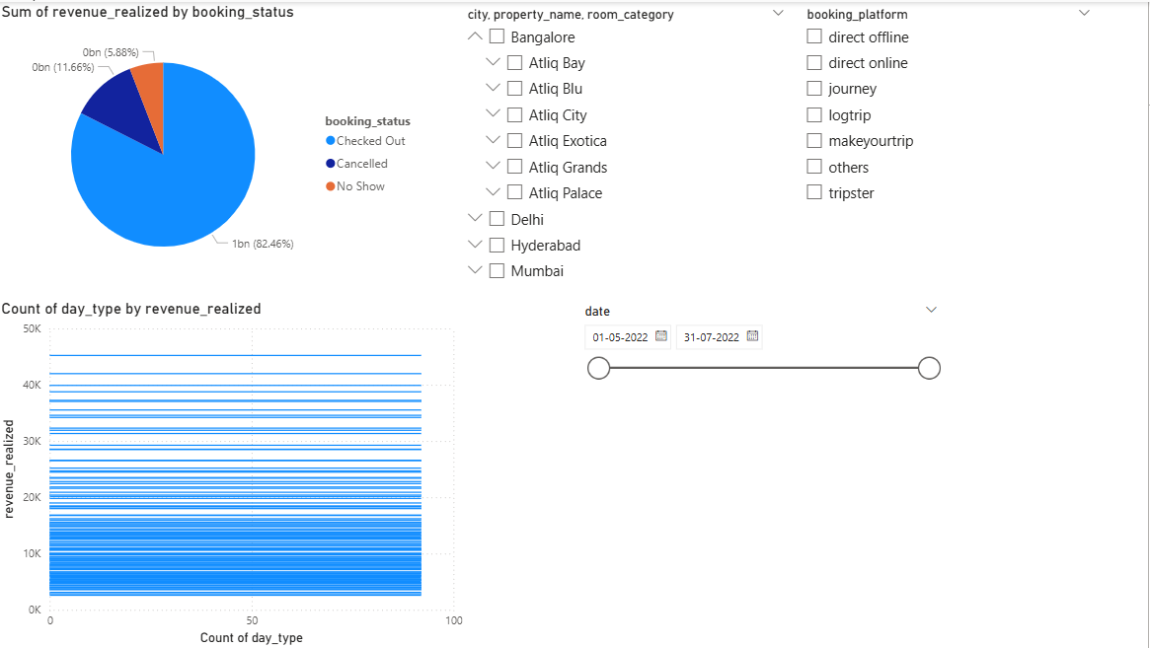
Revenue by Booking Status
Checked-out bookings contribute ~82% of total revenue, forming the primary revenue base
Cancellations account for ~12%, indicating revenue leakage potential
No-shows remain low (~6%), but still impact capacity utilization
Weekdays vs weekends show varied revenue patterns, useful for dynamic pricing

Slide 11
Thank You

